Slide 1

Honest AI: Challenges, Opportunities and Reckonings with Generative AI (Workshop Edition!)
Dr Cameron Edmond
Notes:
(1 min)

Slide 2

Task 1: Your discipline and AI
Think about:
What parts of your practice are you replacing with AI?
Are these the same as the ones you allow your students to use AI for? Why/why not?
Notes:
(5 min)

Slide 3

The plan
Industry concerns and Generative AI.
Intersections with the UN SDGs.
Learning Outcomes and Generative AI.
Bonus: Discipline-specific GenAI module.
Notes:
(5 min)

Slide 4



Industry Concerns in my field
The jury is still out on how the games industry as a whole feels about the use of Generative AI.
My students need to be educated on how Generative AI looks in their portfolios – the doors that it opens, and the ones that is shuts.
Notes:
(2 min)

Slide 5
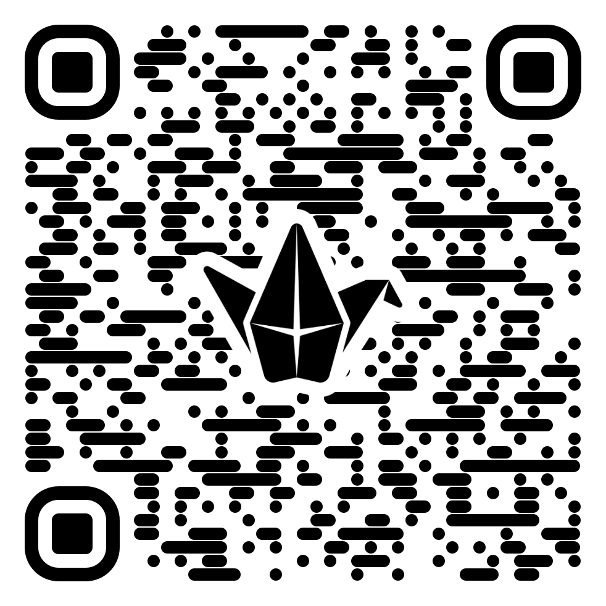
Task 2: Industry Concerns in your field
What are the major industries you “teach for”? Think about how Generative AI is being used in those spaces.
What are some of the concerns around Generative AI in those spaces currently? Are people worried about the loss of jobs, accuracy of work?
Maybe your industry is very Generative AI friendly! In what way?
https://padlet.com/cameronedmond/GenAIConcerns
Notes:
(5 min)

Slide 6
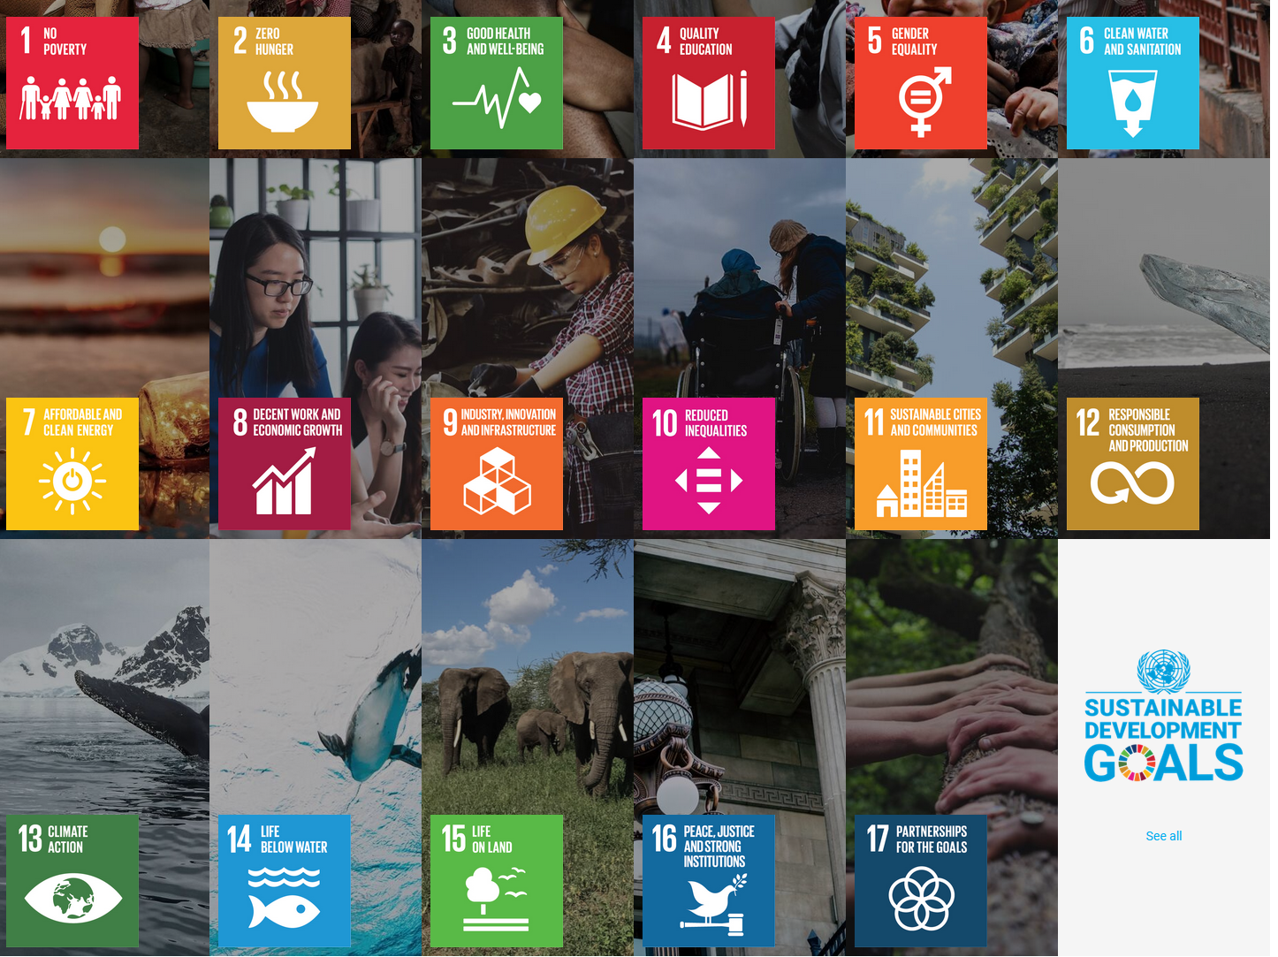
SDGs
Notes:
(1 minute)

Slide 7

SDG Concerns in my field
Generative AI is a disruptive technology. How do we want it to disrupt?
Will it replace jobs? Whose? What do we do for those people?
Will work created with GenAI be meaningful? If not, what becomes of our industry?
The future of many industries will be shaped by how AI is adopted.
When students use GenAI, they are stepping into the arena. Their choices are important.
Notes:
(1 min)

Slide 8
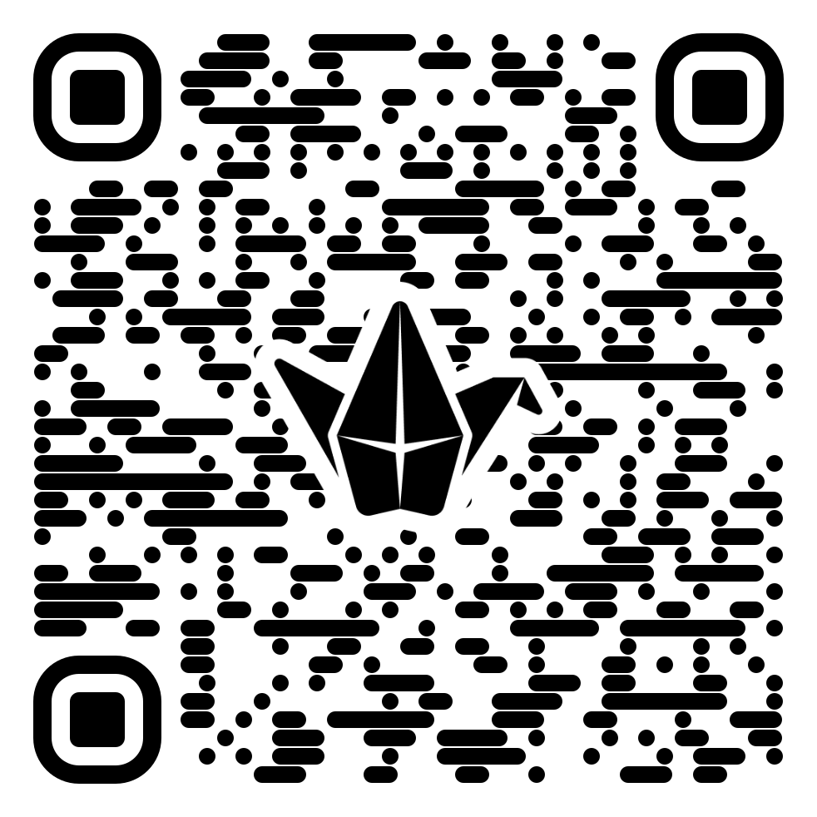
Task 3: SDG concerns in your field
Consider the UN SDGs. Which of these does your field most readily interact with?
How might the adoption of GenAI within your field help or hinder us achieving these goals?
https://padlet.com/cameronedmond/sdgs
Notes:
(5 min)

Slide 9

Learning concerns in my field
Generative AI is changing how we work, but it does sometimes take care of things we might want to assess students on.
There’s a lot of bad game development code out there, and students end up with plausible, good-enough code that they then may translate into bigger projects where problems emerge.
Notes:
(1 min)

Slide 10
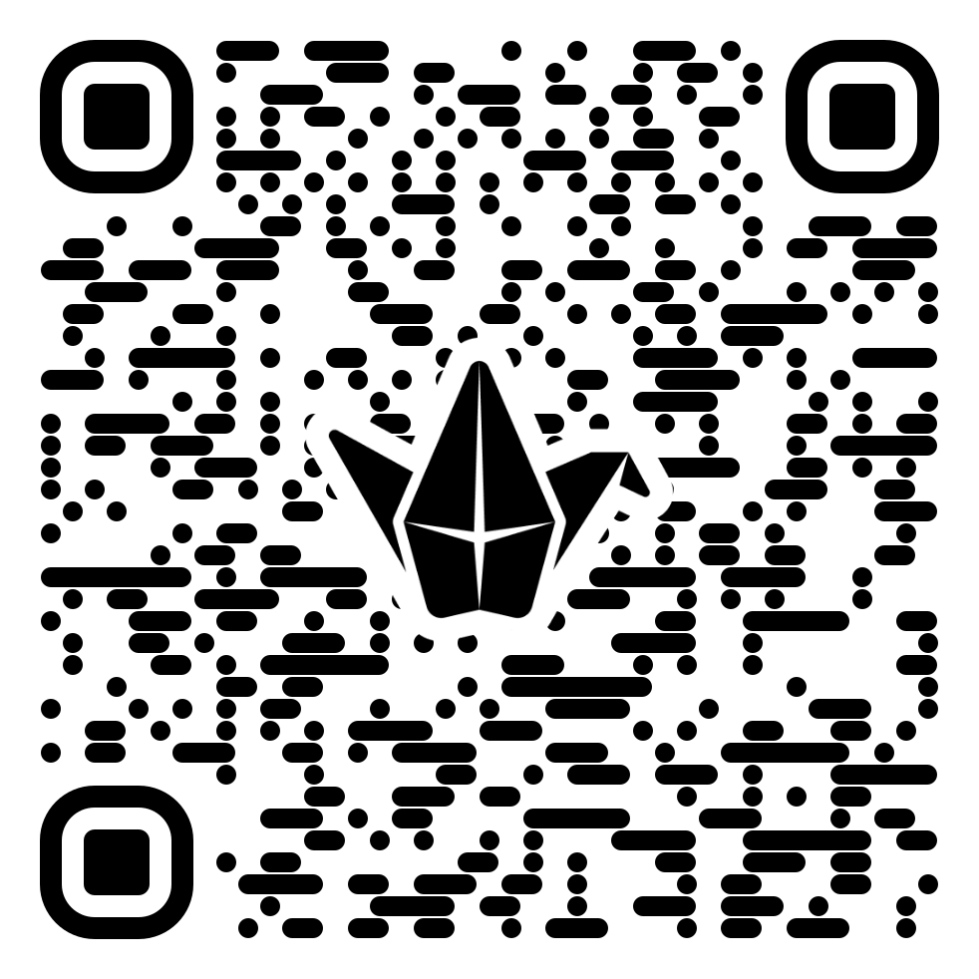
Task 4: Learning concerns in your field
Consider what Generative AI can be used to do in your field. Can it generate reports? Create data visualizations?
What skills do students learn through carrying out these activities? What levels of understanding are skipped through the automation?
https://padlet.com/cameronedmond/learningoutcomes
Notes:
(5 min)

Slide 11
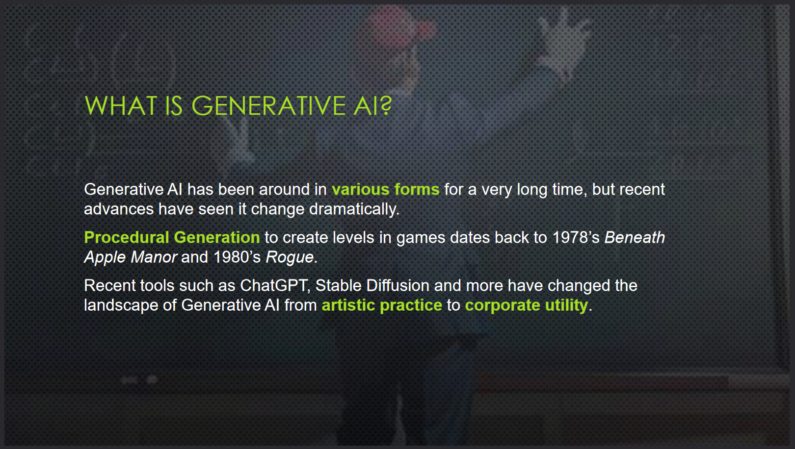
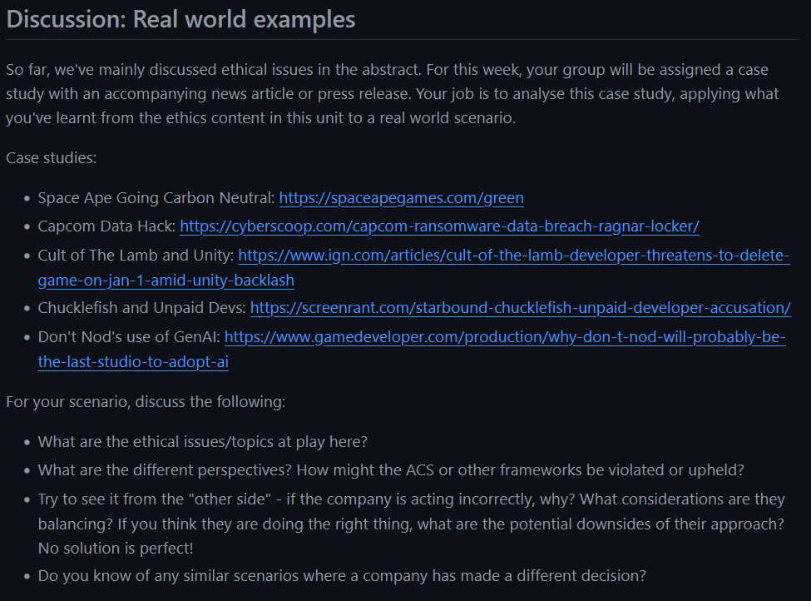
AI and Ethics embedded into content
Class includes a lecture topic on AI and ethical game development, which is then reinforced through a class discussion.
The goal here is not to treat AI as it’s own ethical topic itself, but to showcase how it is embedded many parts of ethical decision making.
Notes:
(2 min)

Slide 12
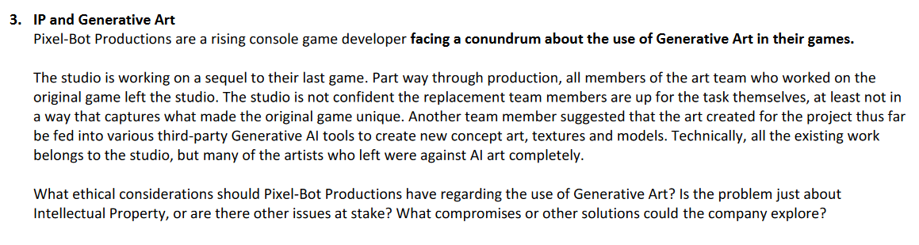
Ethics Essay Topic
Notes:
(1 min)

Slide 13
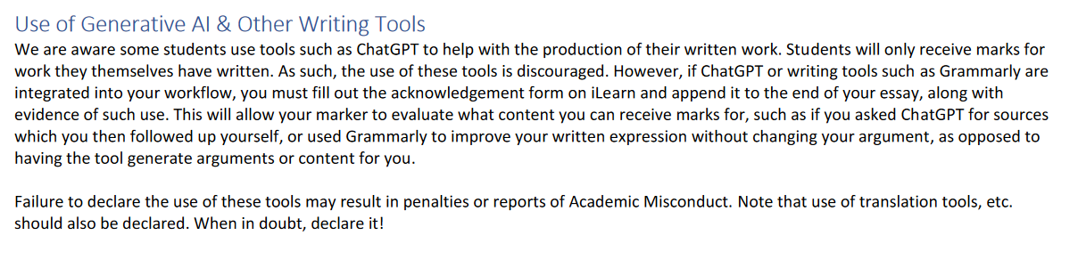
Opening the floor
Notes:
(1 min)

Slide 14
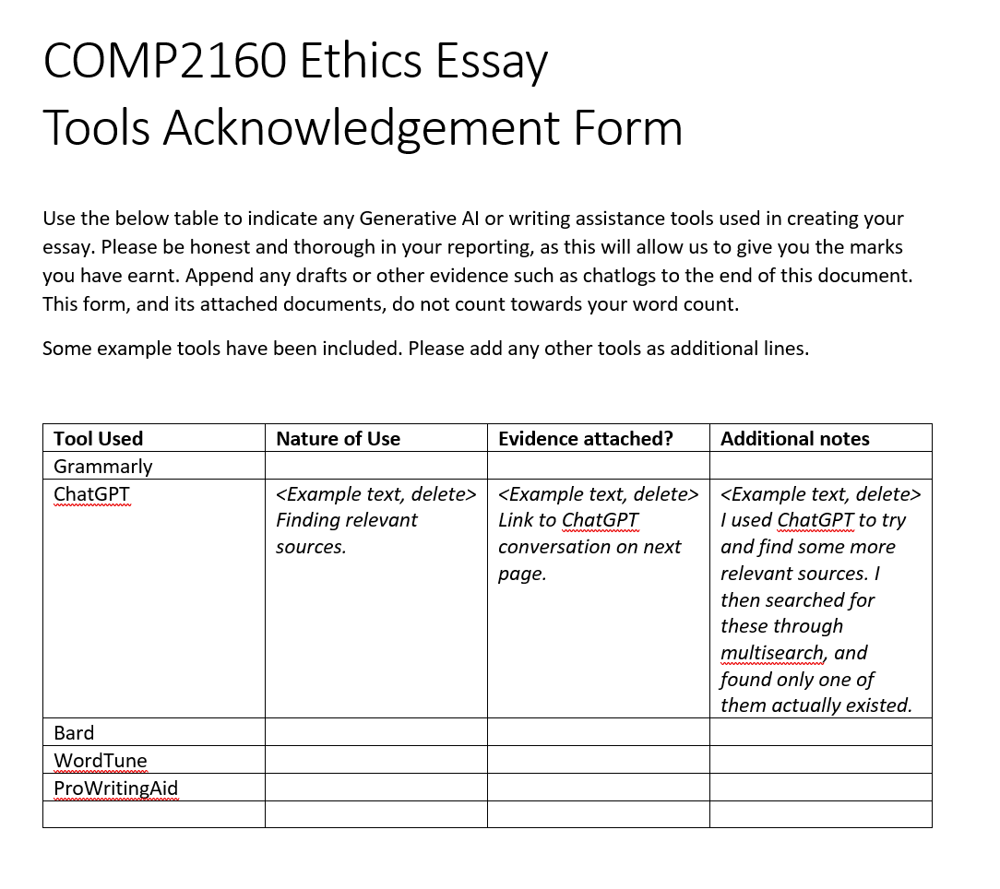
Providing a platform
Notes:
(1 min)

Slide 15

Bonus task: GenAI module
With those around you, discuss how you might create a meaningful module on Generative AI for your discipline (if you are from multiple disciplines, pick one to focus on).
Get ready to present:
What main points would be covered in a lecture/pre-recorded video.
What activity you might have in a tutorial/practical.
What an assessment on Generative AI, or allowing the use of Generative AI, might look like.
Notes:
(10 min)

Slide 16
Thank you!
Barth, R. (2023). The Convergence of AI and Creativity: Introducing Ghostwriter. Ubisoft News. https://news.ubisoft.com/en-us/article/7Cm07zbBGy4Xml6WgYi25d/the-convergence-of-ai-and-creativity-introducing-ghostwriter
Berthelot, A., Caron, E., Jay, M., & Lefèvre, L. (2024). Estimating the environmental impact of Generative-AI services using an LCA-based methodology. Procedia CIRP 122. https://doi.org/10.1016/j.procir.2024.01.098
Bolukbasi, T., Chang, K-W., Zou, J. Saligrama, V. & Kalai, A. (2016). Man is to Computer Programmer as Woman is to Homemaker? Debiasing Word Embeddings. Advances in Neural Information Processing Systems 29 (NIPS 2016). https://doi.org/10.48550/arXiv.1607.06520
Hicks, M.T., Humphries, J. & Slater, J. (2024). ChatGPT is bullshit. Ethics Inf Technol 26, 38. https://doi.org/10.1007/s10676-024-09775-5
Ho, K.K. (2024). Database of 16,000 Artists Used to Train Midjourney AI, Including 6-Year-Old Child, Garners Criticism. ARTNews. https://www.artnews.com/art-news/news/midjourney-ai-artists-database-1234691955
Li, P., Yang, J., Islam, MA. & Ren, S.(2023). Making AI Less "Thirsty": Uncovering and Addressing the Secret Water Footprint of AI Models. Pre-print. https://doi.org/10.48550/arXiv.2304.03271
Rane, N. (2023). Roles and challenges of ChatGPT and similar generative artificial intelligence for achieving the sustainable development goals (SDGs). Available at SSRN 4603244. http://dx.doi.org/10.2139/ssrn.4603244
Thiel, D. (2023). Identifying and Eliminating CSAM in Generative ML Training Data and Models. Stanford Digital Repository. https://doi.org/10.25740/kh752sm9123

